Slide 1
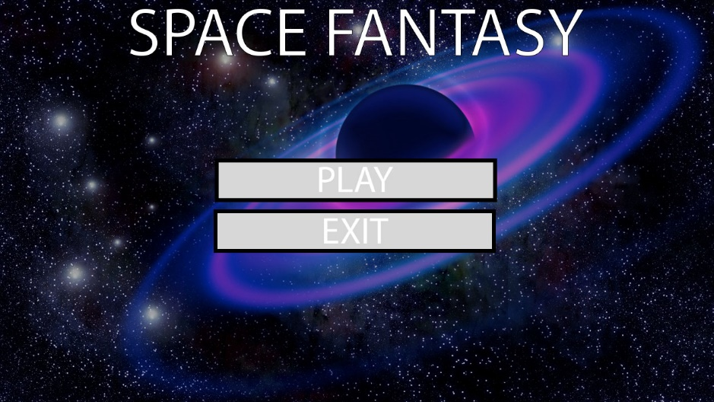
Space Fantasy
JOGY
JOGY STUDIOS Ltd.

Slide 2
User Features

Slide 3
Contributions

Slide 4
Class Diagram

Slide 5
Test Plan

Slide 6
UI Design Java

Slide 7
UI Design Photoshop

Slide 8
Implementation

